Slide 1
Dual use
Challenges and opportunities
November 14th 2023
Dr. John Pearson – Flemish Peace Institute

Slide 2
Table of contents
Historical context
International context
Consquencies for the future

Slide 3
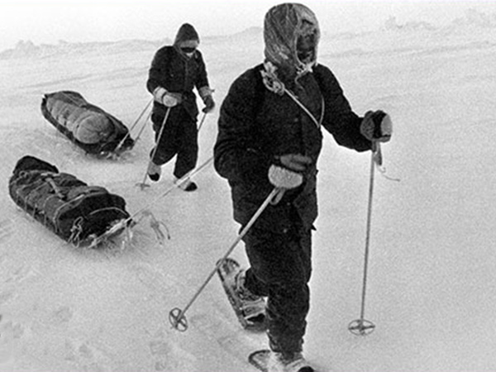
‘Dual-use’
Basic definition
Items that potentially have both military and civilian applications
Can be items subject to formal export controls
Can also be items that are not controlled but which have potentially problematice applications

Slide 4
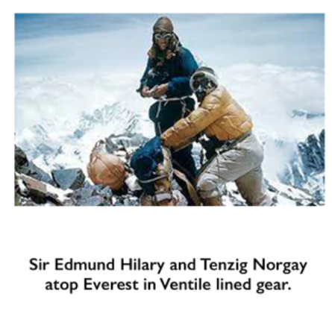
Example 1: Ventile
Technical outdoor cotton fabric
Developed before WWII
Innovative uses found by British RAF and Navy
Used to make immersion suits for pilots and sailors
Increased survival rates
Later adopted for arctic and mountain exploration

Slide 5
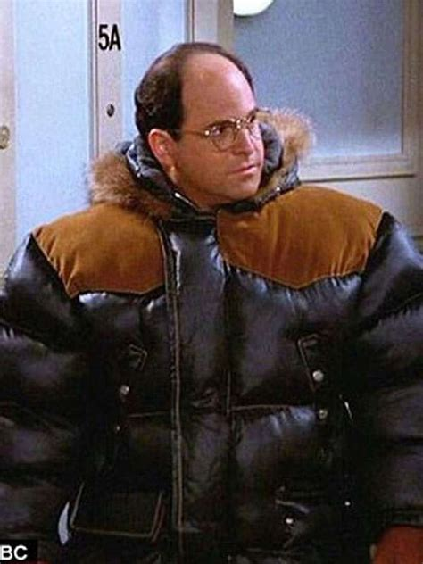
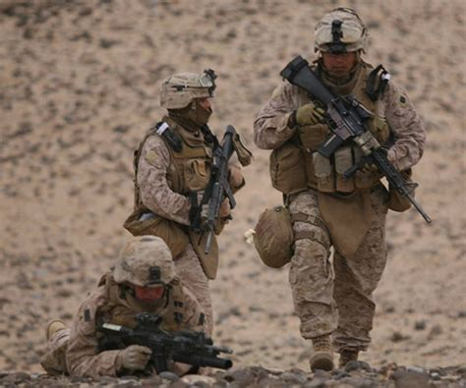
Example 2: Gore-tex
Technical outdoor fabric
Discovered by coincidence in 1969
Stretched PFTE tape is durable and porous but can be used to make waterproof fabric
Originally used in civilian outdoor clothing
Now widely used in military clothing, in versions not available to public

Slide 6
What do these examples tell us?
Evolutions in dual-use innovation and practice
Reversal of innovation flows
Military-civilian – civilian-military
Not always ‘bad’ or problematic innovations
But some are!
Unpredictable innovation flows
Often coincidental discoveries

Slide 7
Reversal of innovation flows
Military-civilian – civilian-military
Military innovation interesting for civilians because of more demanding parameters
Civilian innovation processes are often faster and more flexible than military
Challenge
Civilian and military actors not always used to working together
Some actors hide their military affiliations to work on sensitive projects

Slide 8
2) Good or problematic innovations?
Many dual-use projects can lead to beneficial civilian innovations
Involvement of military partners is not inherently problematic
Most problematic projects often involve low-probability – high-impact risks
Challenge
What do we need to control?
How to keep controls proportionate?

Slide 9
3) Unpredictable innovation flows
Gore-tex originated from experiment to make a new insulation tape
Hard to foresee military application at the beginning
Challenge
People involved may not know their work has military applications

Slide 10
How to make researchers aware – without making them feel overwhelmed?

Slide 11
A suggestion
Adapting the dual-use export control structure
- Based on EU Dual-use Regulation 2021/821
Three types of control
Item control
listed items based on multilateral export control lists
Trajectory control
Countries subject to embargoes or other export measures
End-user control
Military users, users producing WMD, or users subject to sanctions

Slide 12
Item control
Content questions
Trajectory
Country questions
End-user
Partner questions

Slide 13
‘Content questions’
What is the content and output of the project?
Does it involve unusual or novel applications?
Does it involve extreme or highly demanding situations?
Does it involve very high or stringent parameters?

Slide 14
‘Country questions’
Which countries are involved?
Are they subject to sanctions or other measures?
Do you have experience with working with this country?

Slide 15
‘Partner questions’
Which partner organisations or individuals are involved?
Have you worked with this partner before?
What was your experience?
Is it a partner in a similar field to yours? Are they well known in that field?
Is it easy to find information about new partners?

Slide 16
Aim
The aim is to identify possible challenges as early as possible
Questions can be asked in an informal way in the early stages
More detailed versions of questions can be asked later
Questions overlap somewhat with dual-use export control questions
Extra attention is needed for projects where there are serious potential challenges and/or where information is incomplete or not available

Slide 17
Discussion
Experiences of dual use at tech transfer offices
Do you encounter a lot of dual-use projects?
In which areas in particular?
What challenges do you face?
What would help most in addressing the challenges?

